Slide 1
Modal analysis
Methodology:
The modal analysis is performed on in built MDI Demo vehicle using different four methods.
Questions:
In every analysis mode frequency and mode number is changed. In some analysis some frequencies are added while in other they are missing.
Why this is happening?
Which method is correct for modal analysis?
How to obtain strain energy, kinetic energy while using Adams Linear method for modal analysis?
This results are confusing so that we are getting different results on our own vehicle model. Please suggest correct method.
Please explain correct method for doing Modal analysis in Adams Car.

Slide 2
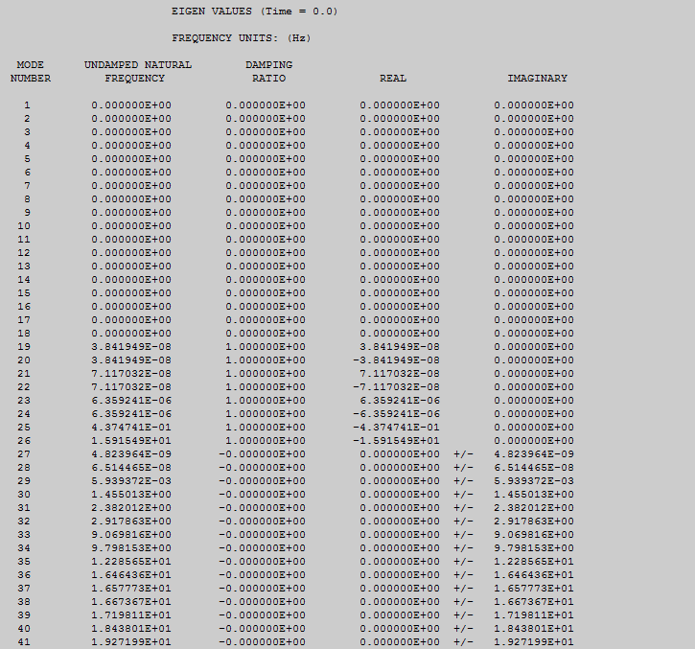
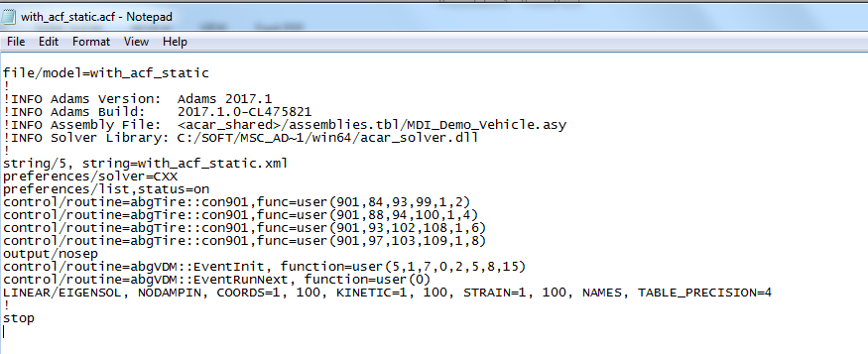
Method 1: Running static euilibrium interactive simulation, after getting .acf file , following line is added in .acf file ‘’ LINEAR/EIGENSOL, NODAMPIN, COORDS=1, 100, KINETIC=1, 100, STRAIN=1, 100, NAMES, TABLE_PRECISION=4” after that simulation is run using .bat file.
Mode shape obtain are above

Slide 3
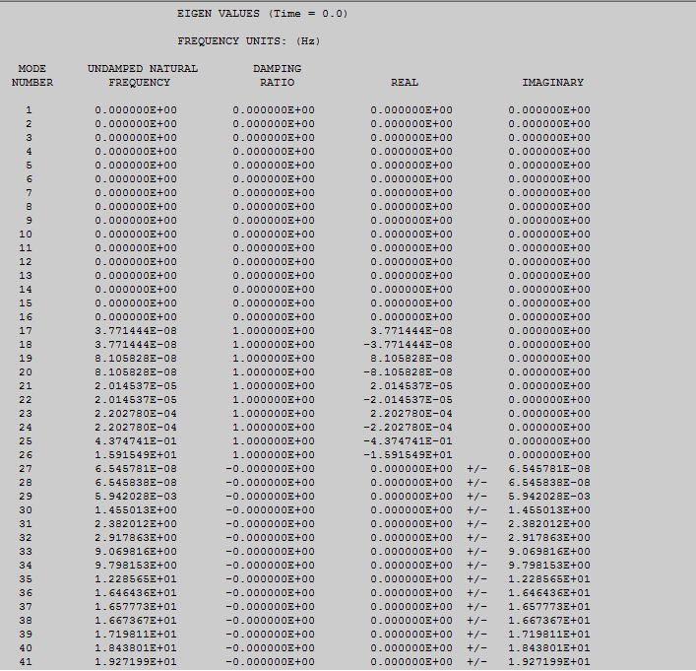
Method 2: Running static euilibrium files only simulation, after getting .acf file , following line is added in .acf file ‘’ LINEAR/EIGENSOL, NODAMPIN, COORDS=1, 100, KINETIC=1, 100, STRAIN=1, 100, NAMES, TABLE_PRECISION=4” after that simulation is run using .bat file.
Mode shape obtain are above

Slide 4
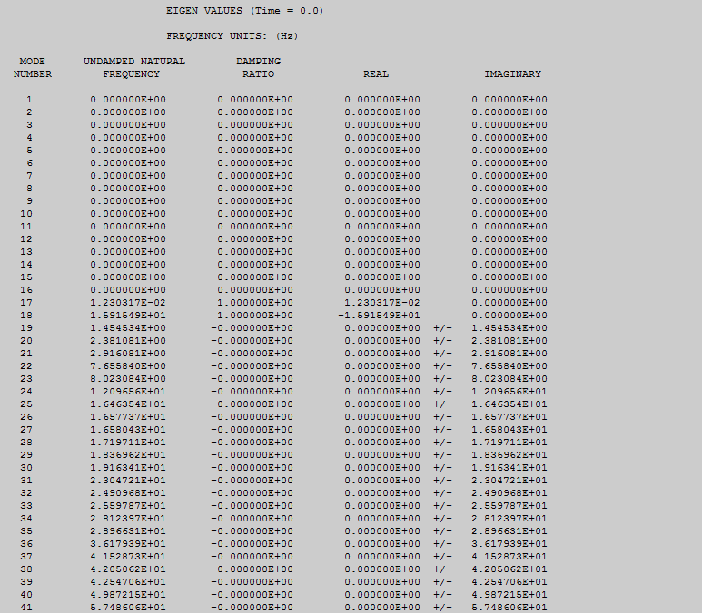
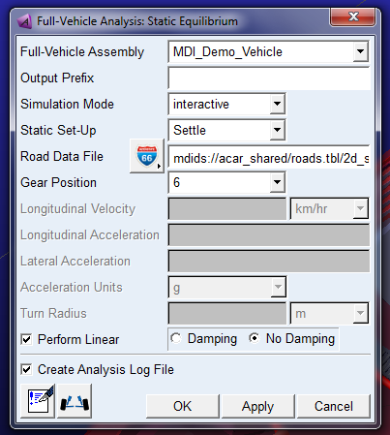
Method 3: Analysis is run using static equilibrium, Linear box check and No damping
The mode shapes are obtained are above

Slide 5
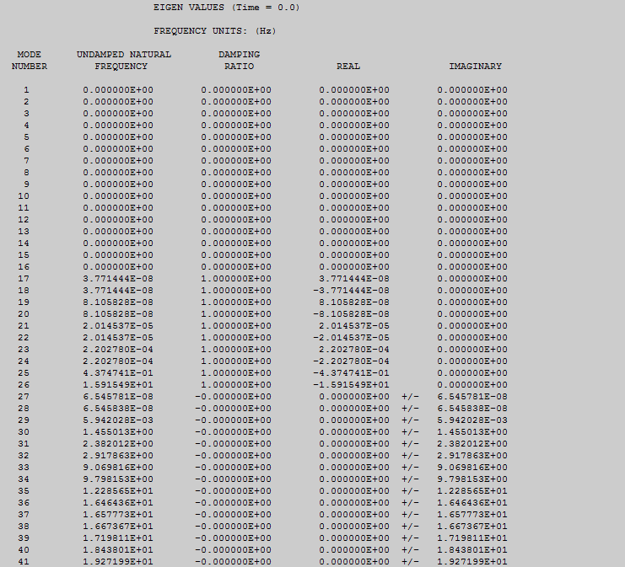
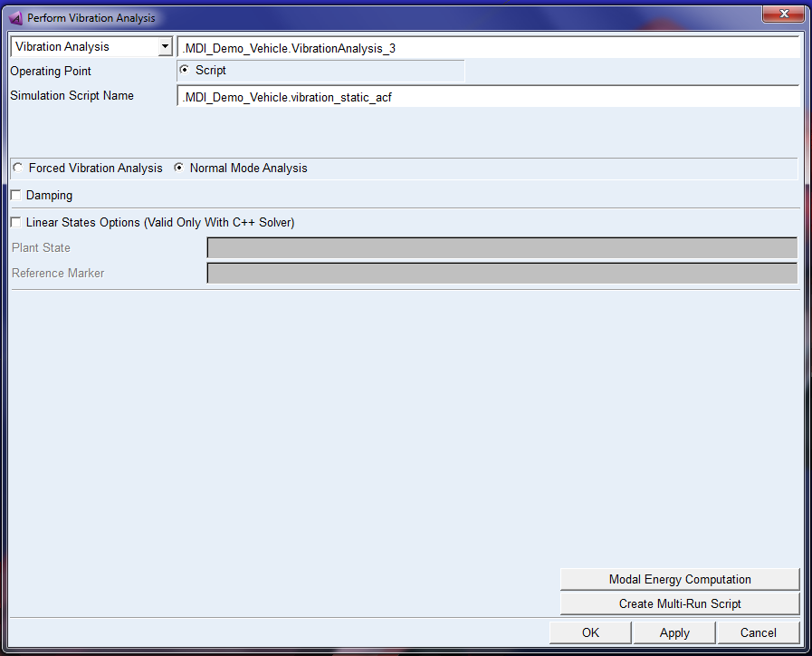
Method 4: Static equilibrium is performed, .acf script file used to performed modal using vibration analysis.
Modes obtain are above

