Slide 1
Cadence forum question(2)_yysunj

Slide 2
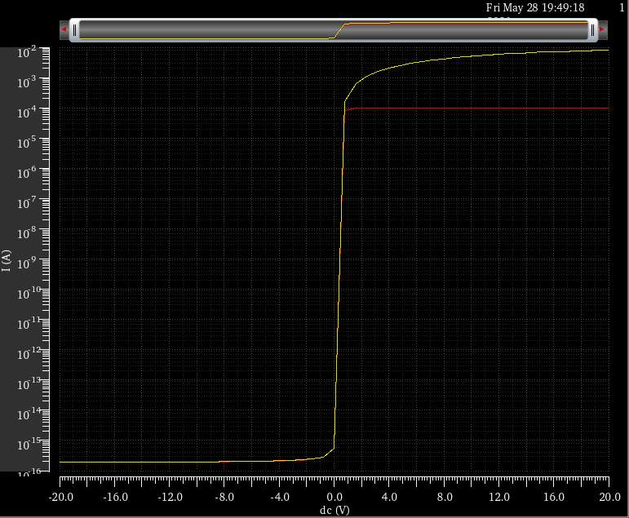
Transfer curve_ W = 1 m L = 10 μm
0.1 V : Red
10 V : Yellow

Slide 3
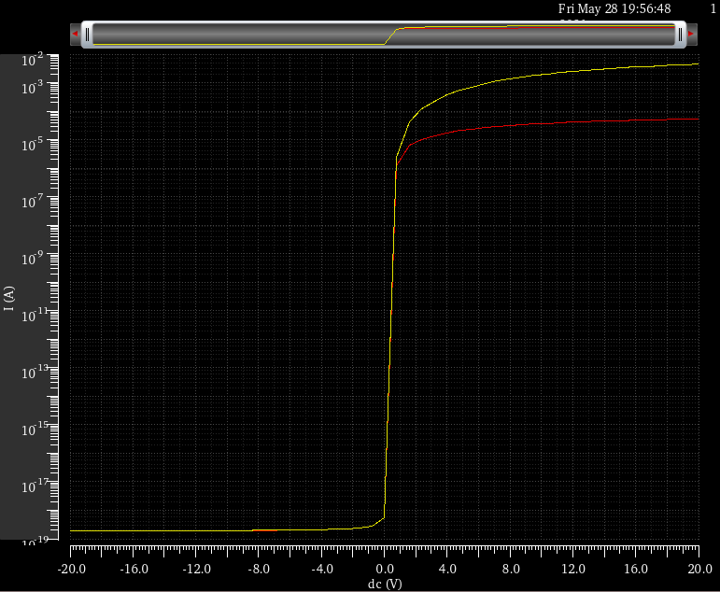
Transfer curve_ W = 1 mm L = 10 μm
0.1 V : Red
10 V : Yellow

Slide 4
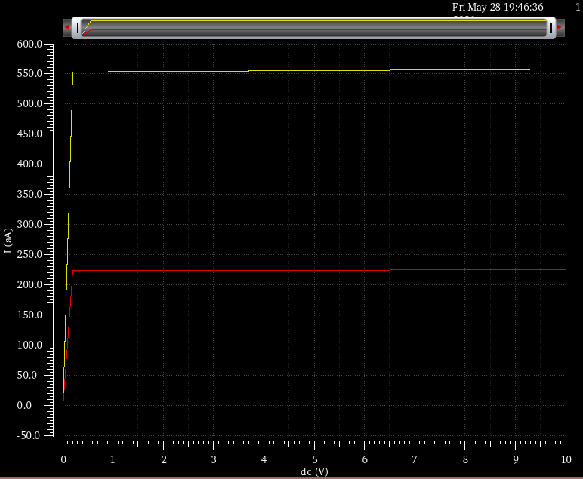
Output curve_ W = 1 m L = 10 μm
Vgs -3 V : Red
Vgs 0 V : Yellow

Slide 5
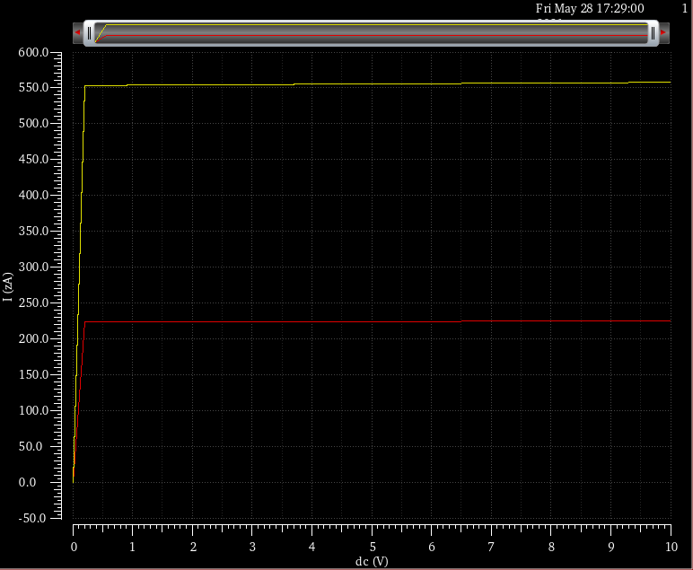
Output curve_ W = 1 mm L = 10 μm
Vgs -3 V : Red
Vgs 0 V : Yellow

Slide 6
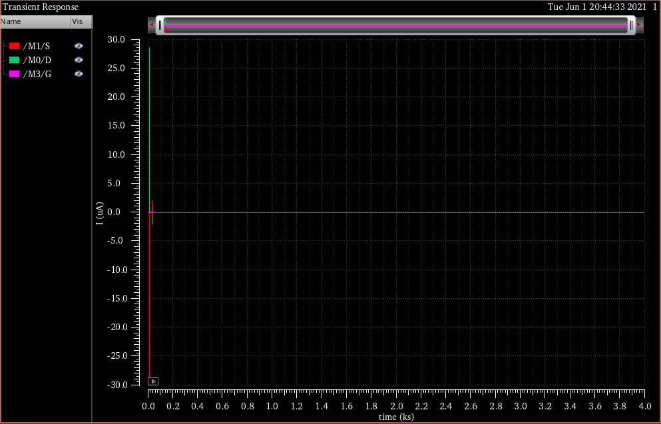
Result of performed transient simulation_Linear scale

