Slide 1
Cadence forum question_yysunj

Slide 2
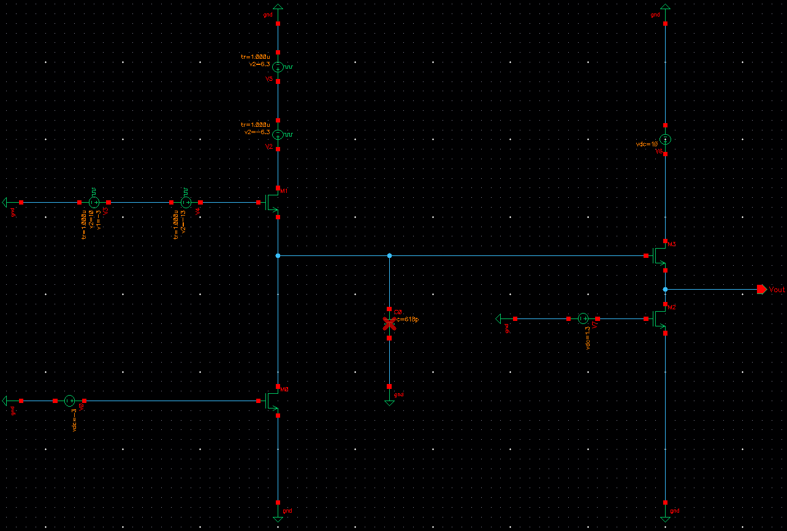
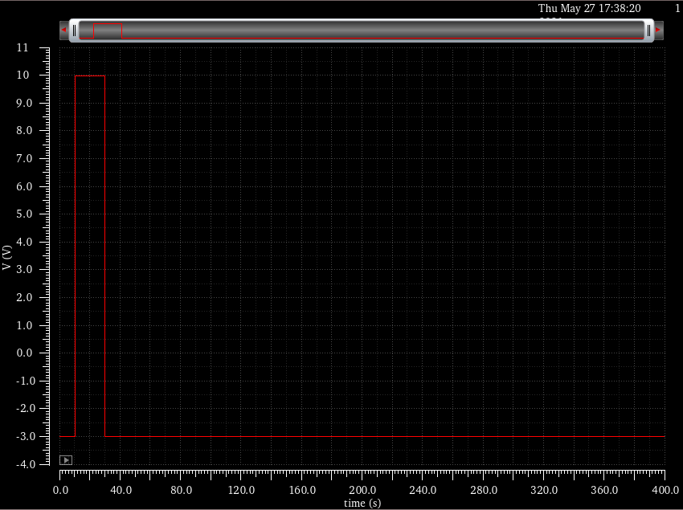
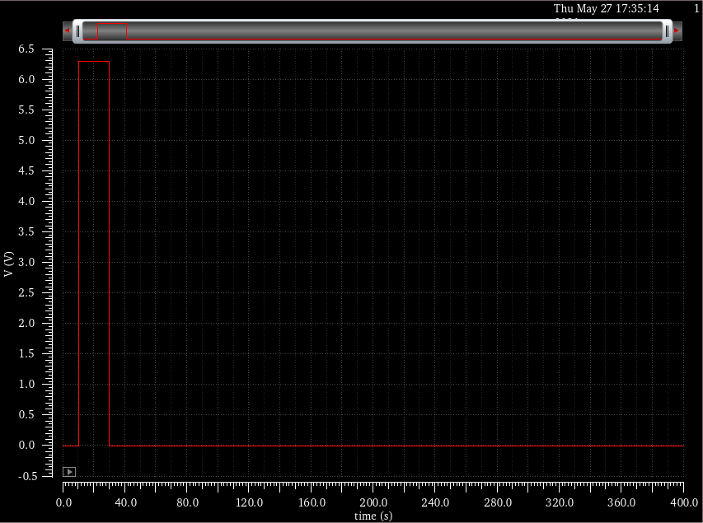
Circuit and applied voltages
Pulse 2
10 V
M3
Programming circuit (M1)
Pulse 1
Node N
1.3 V
Reading circuit
Pulse 1
DUT (M0)
-3 V
DUT : Width 1 m Length 10 um
Programming circuit : Width 10 um Length 10 um
Reading circuit : Width 100 um Length 10 um
Pulse 2

Slide 3
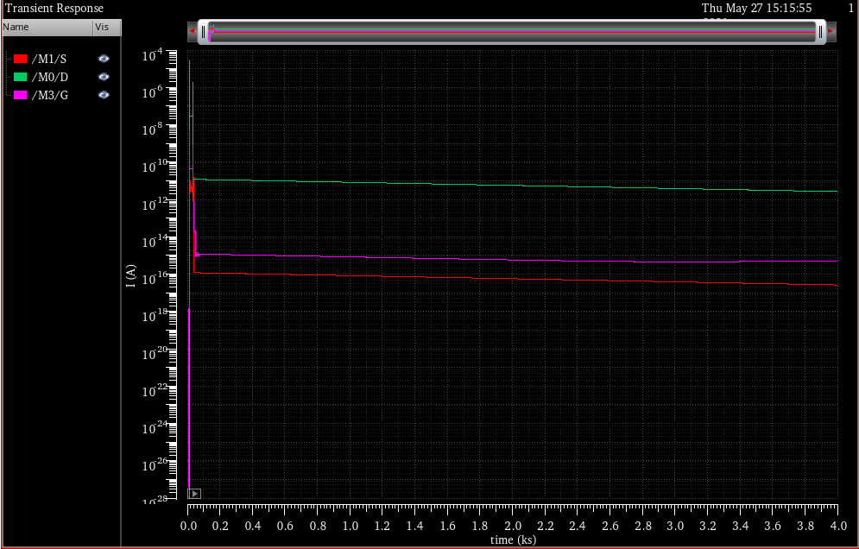
Result of performed transient simulation
According to KCL, M1/S + M0/D + M3/G = 0.
But, this result does not satisfy above equation.

